Slide 1
Lecture 6
Advanced Algorithm Analysis

Slide 2
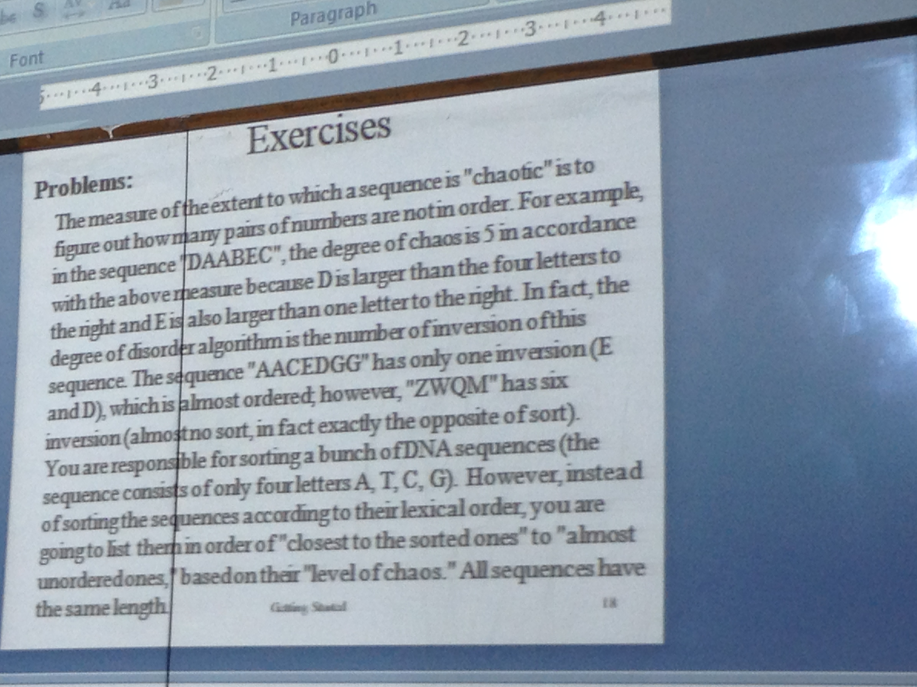
Exercise

Slide 3
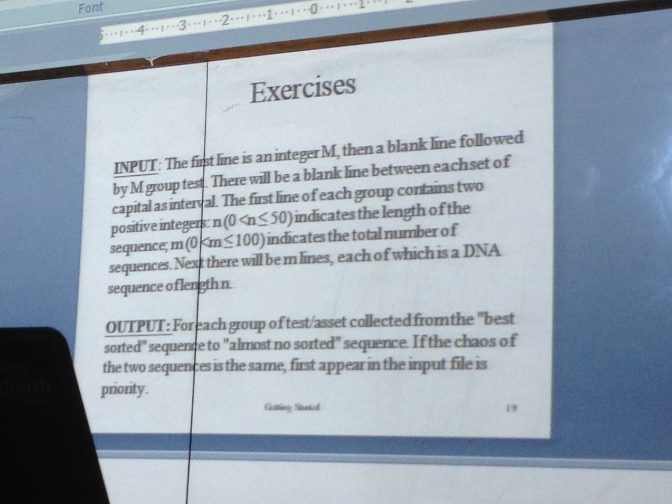
Exercise (contd…)

Slide 4
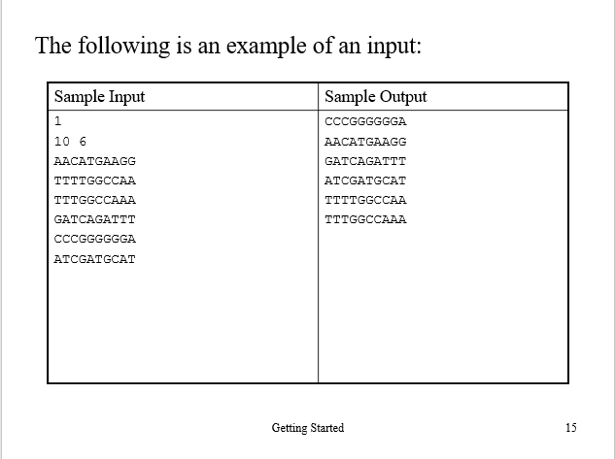
Exercise (contd…)

Slide 5
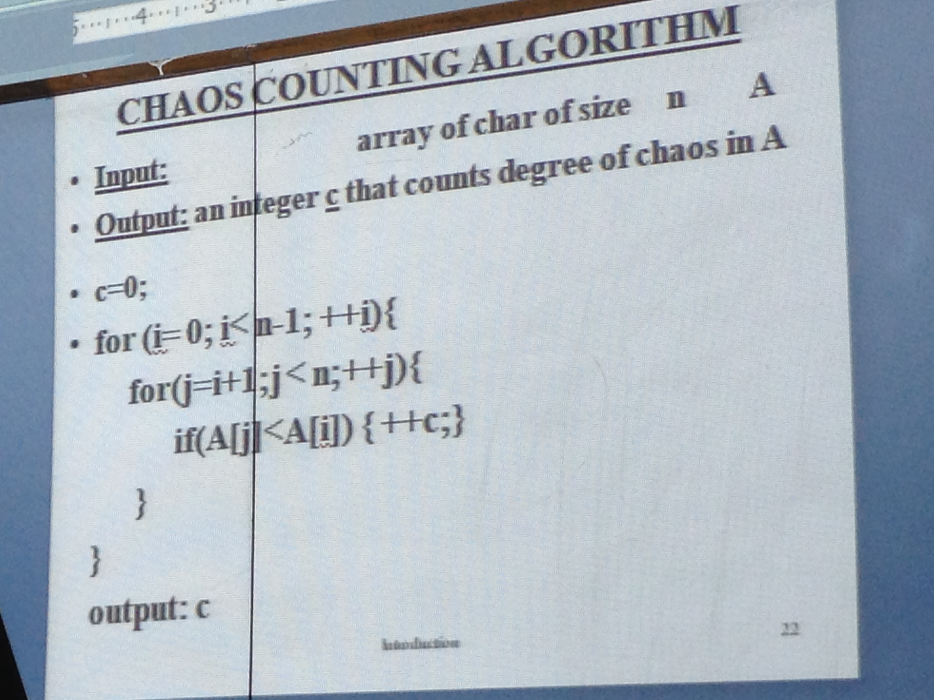
Chaos Counting Algorithm

Slide 6
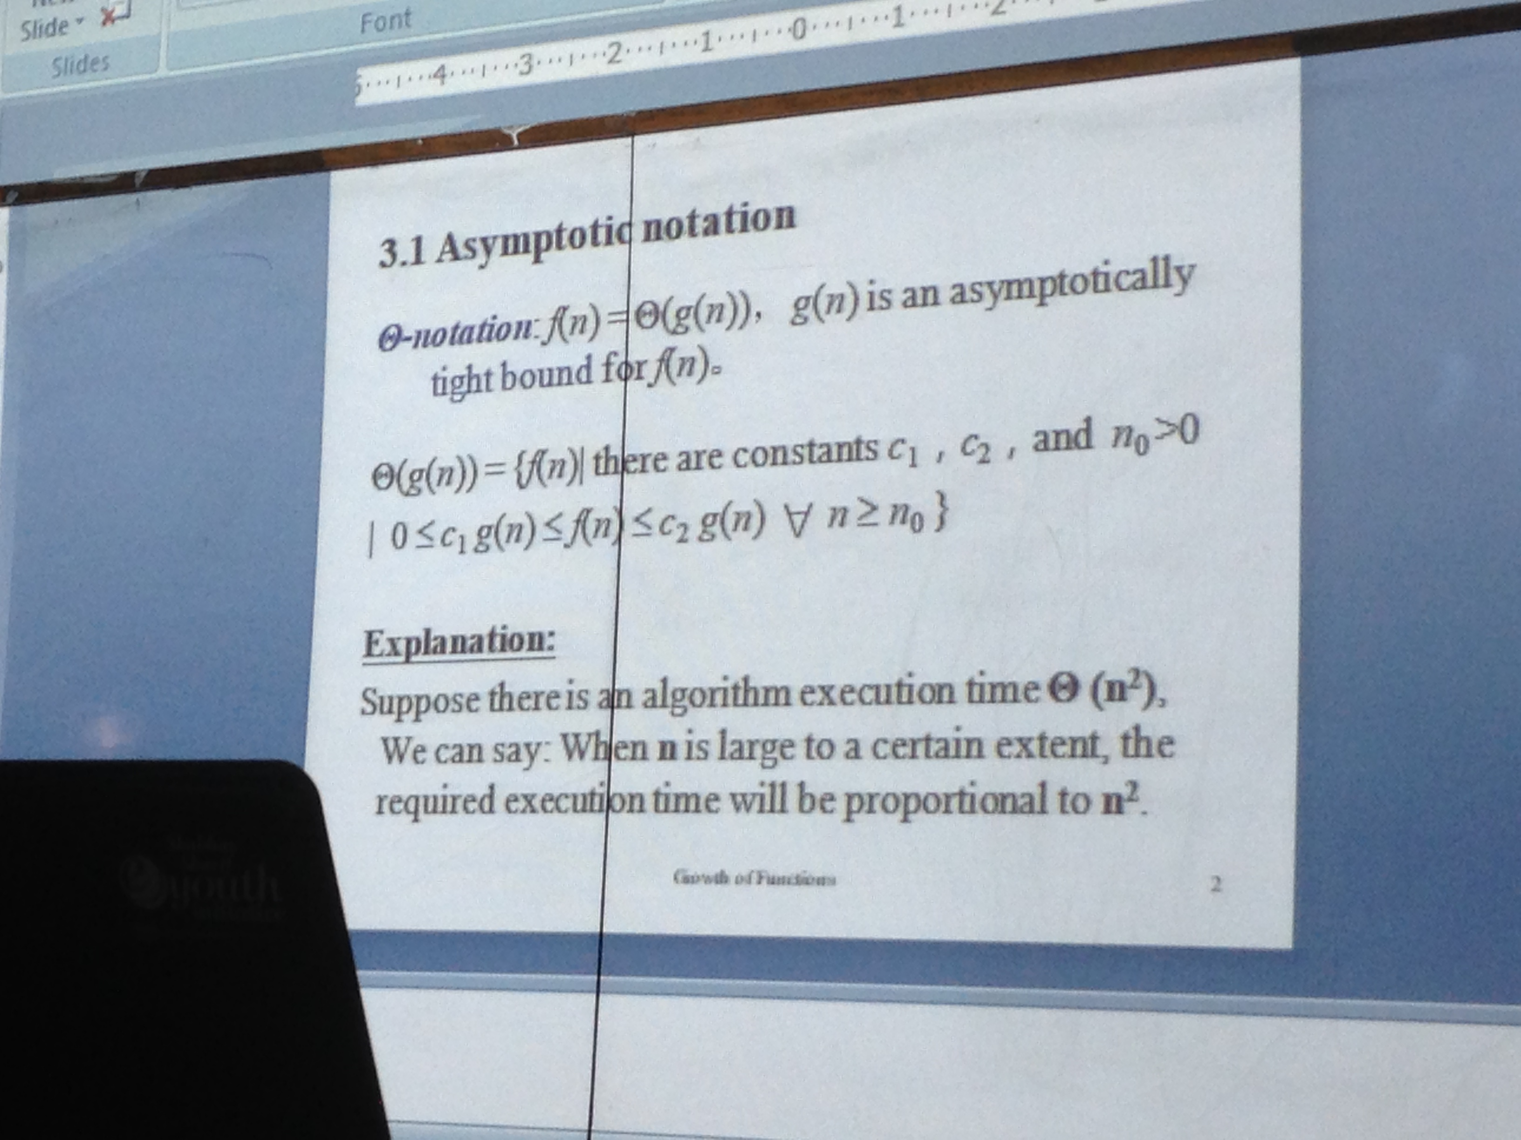
Asymptotic Notation

Slide 7
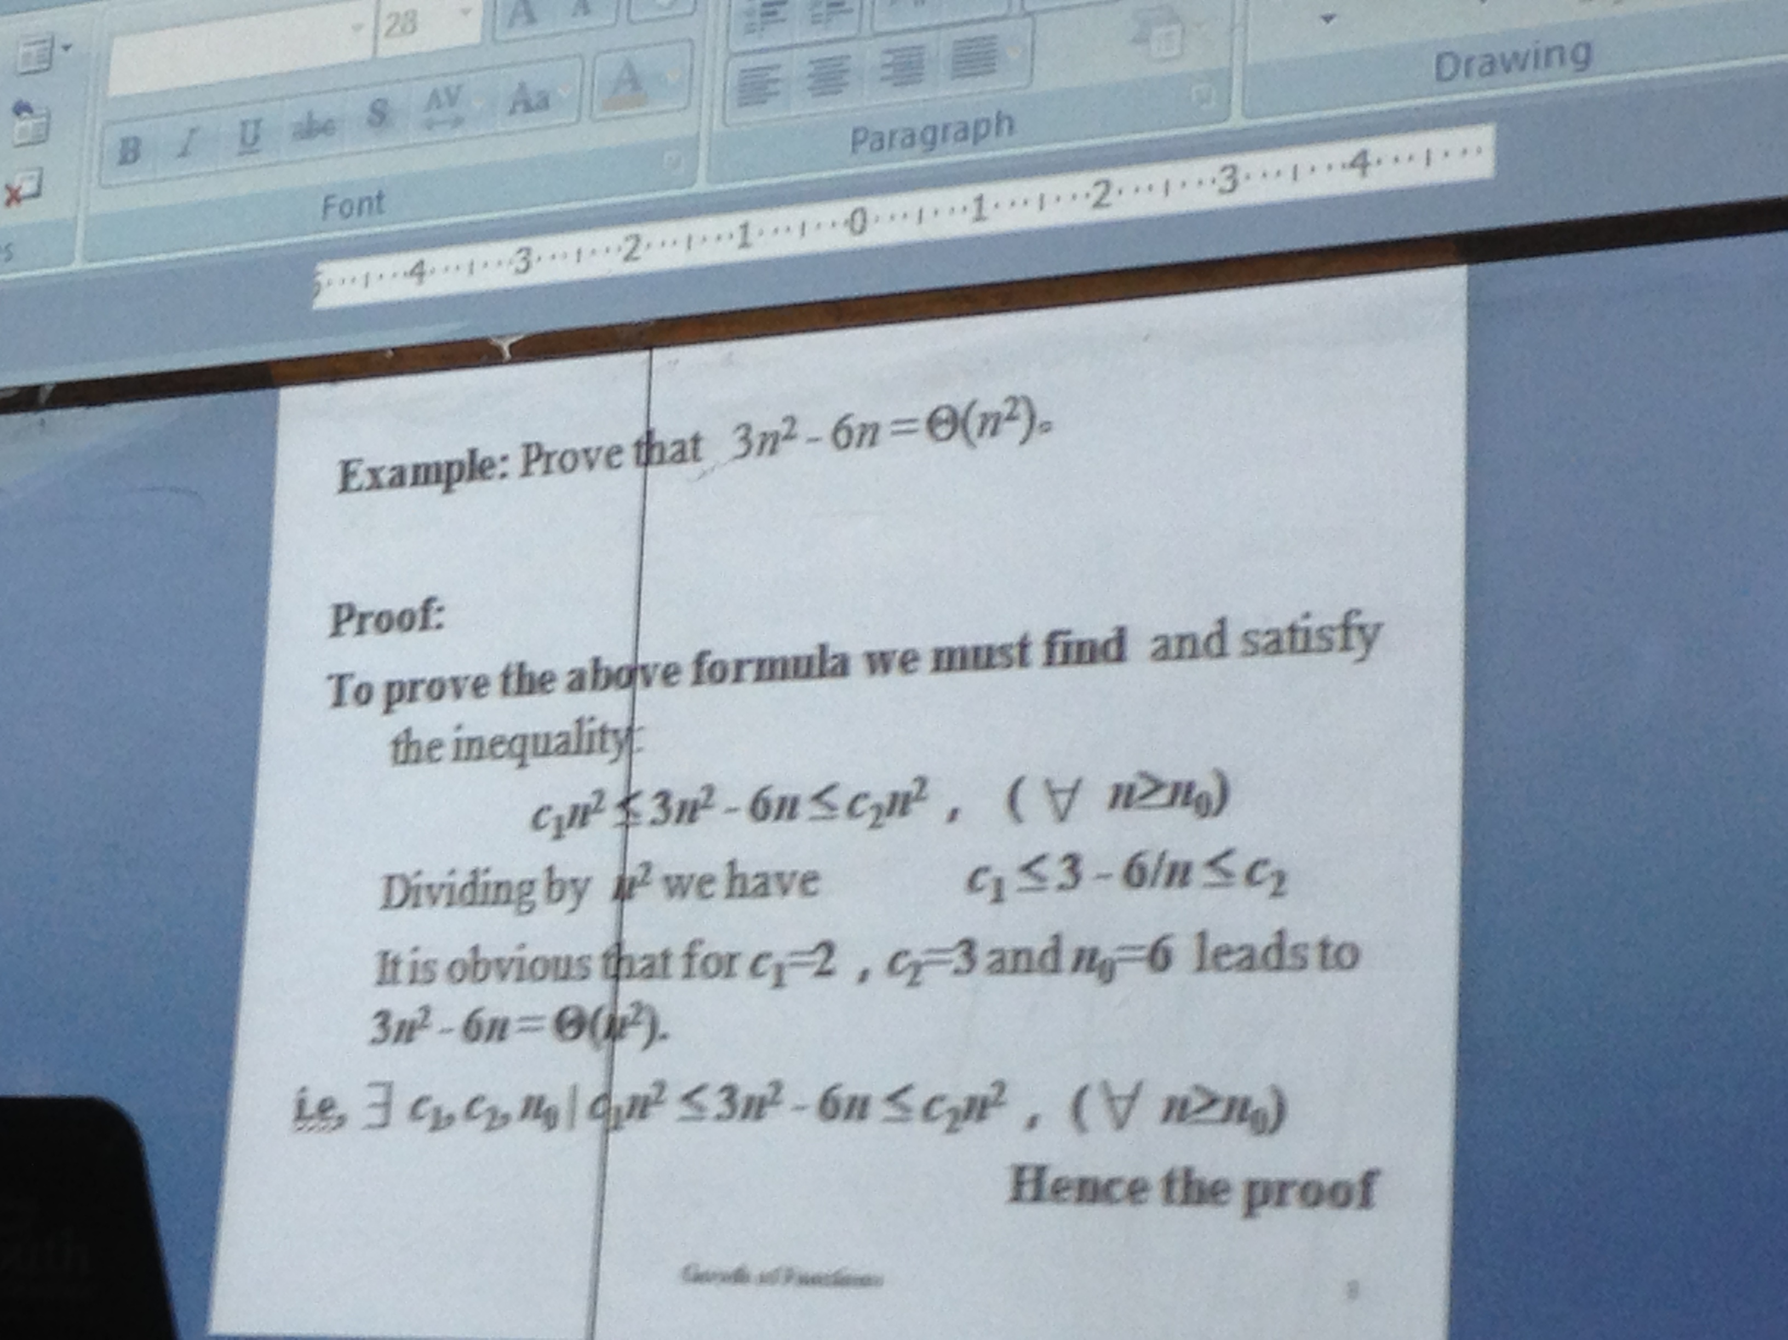
Asymptotic Notation (contd…)

Slide 8
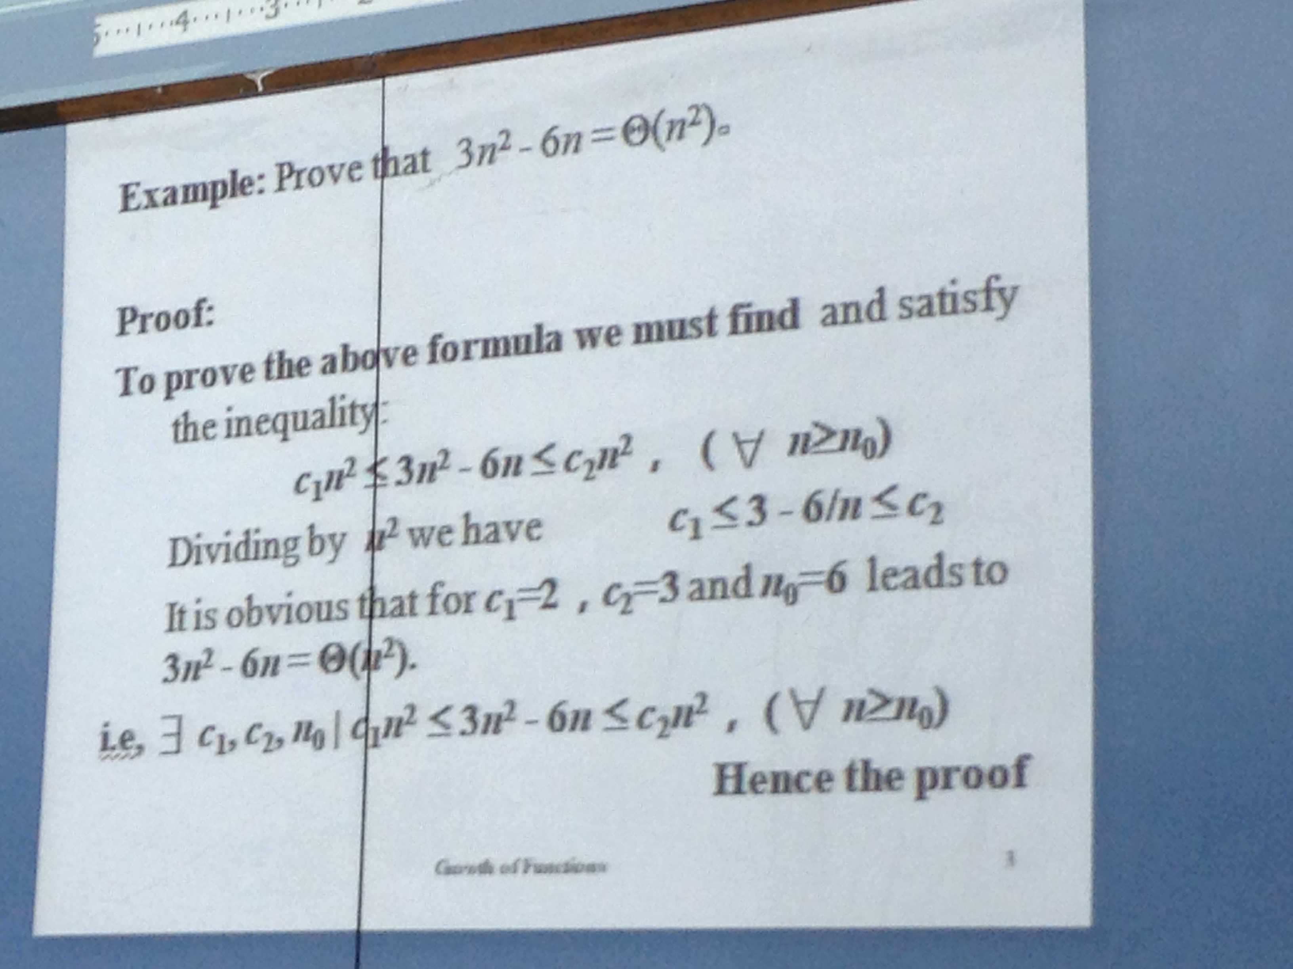
Asymptotic Notation (contd…)

Slide 9
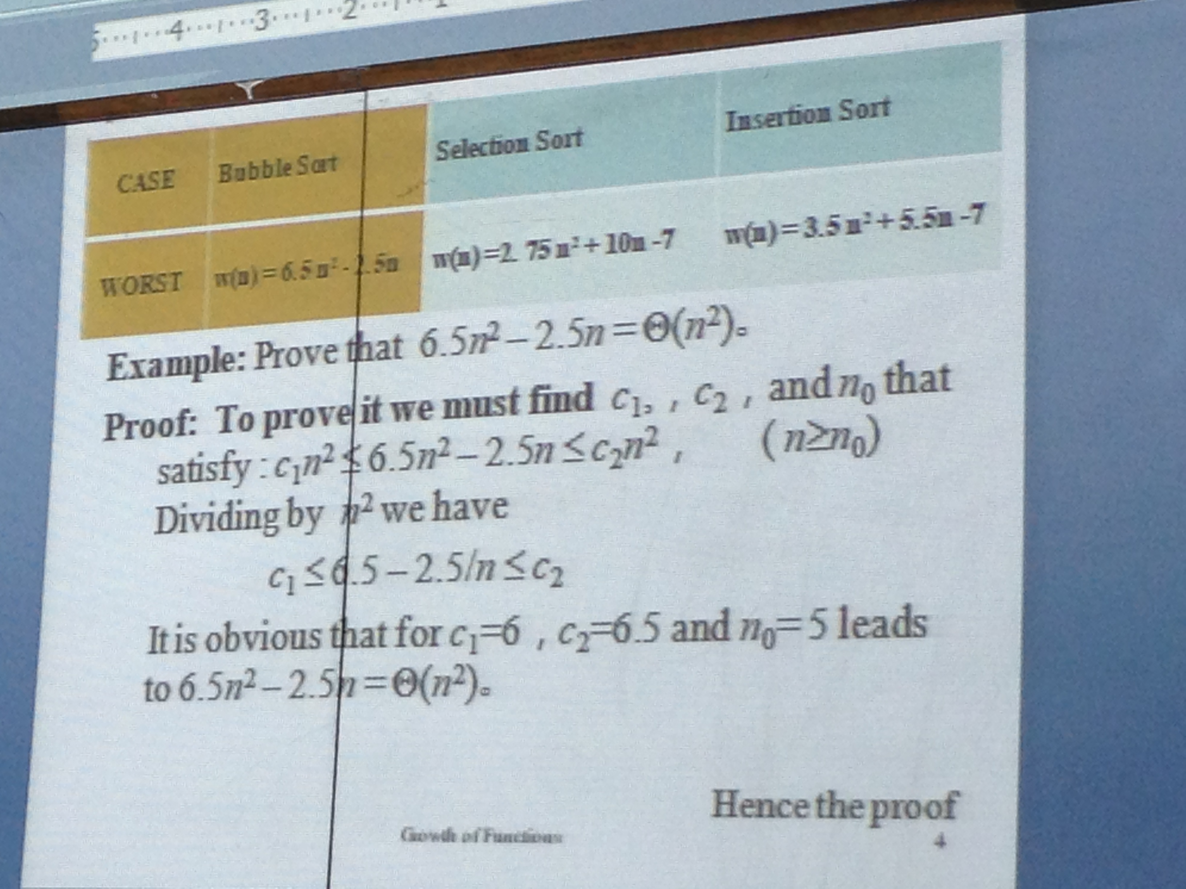
Asymptotic Notation (contd…)

Slide 10
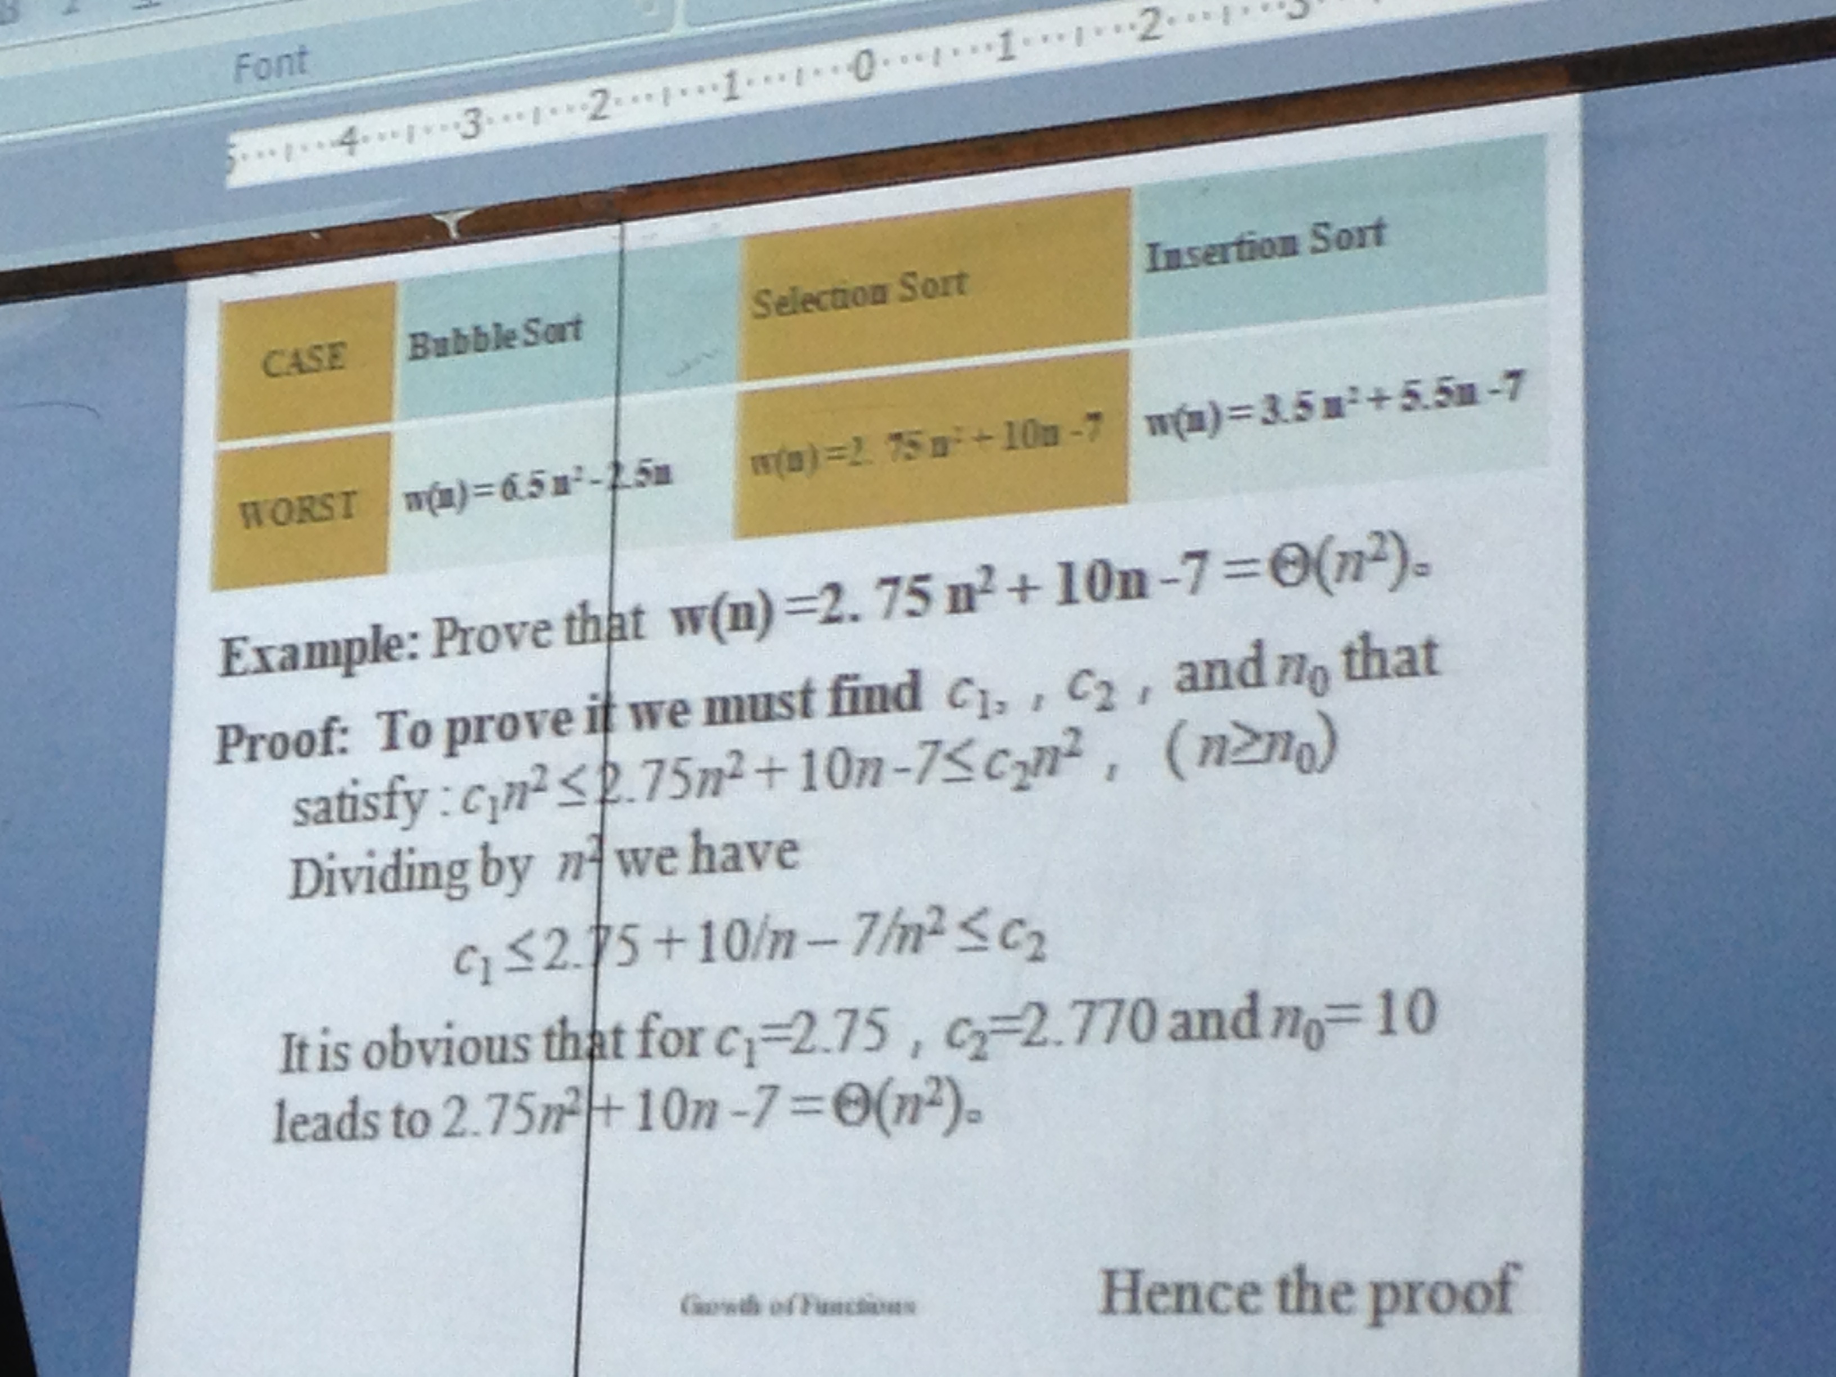
Asymptotic Notation (contd…)

Slide 11
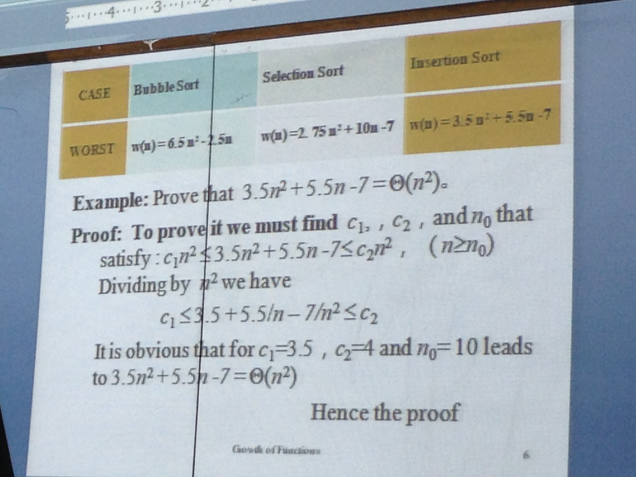
Asymptotic Notation (contd…)

Slide 12
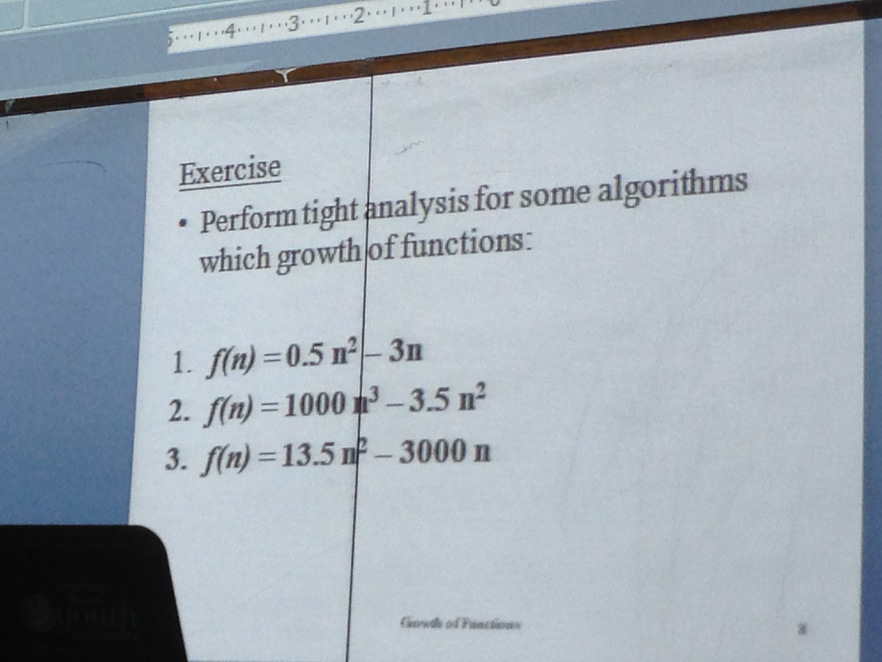
Asymptotic Notation Exercise Problems

